Slide 1
Security Challenges in a Connected World
ISACA Roundtable, Breukelen, The Netherlands
March 2013
Yiru Zhong, Analyst
Information & Communications Technologies

Slide 2
Discussion topics
Machine-to-Machine (M2M), hyperconnected society and security
Security challenges in specific M2M verticals
Securing M2M deployments
Changing mindsets of digital citizens

Slide 3
A more holistic view on security must prevail
Enterprise customers
Standard-isation bodies
Service providers
Secure M2M deployments can be a differentiating factor in the market
Overcomes coordination challenges
Customers push for a holistic view on security
Notes:
The key messages out of this short presentation are:
1. There will be an increasing push by customers to demand a deployment that already

Slide 4
Machine-to-Machine (M2M), hyperconnected society and security

Slide 5

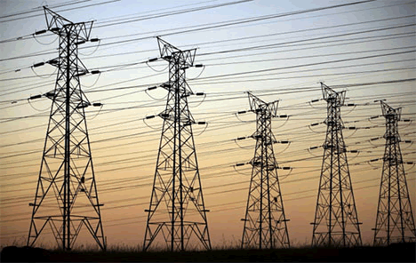

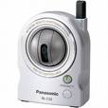
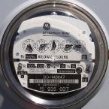

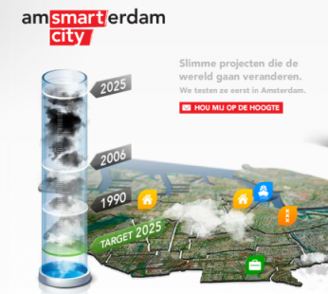

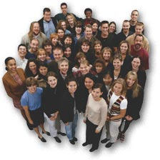
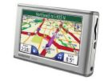



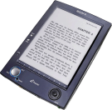
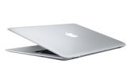


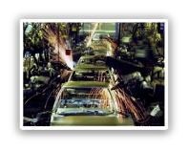


A hyperconnected world will link objects to machines to humans
Internet of things >2020
M2M: “50 billion
connected devices by 2020”
Human Communications:
5.2billion mobile subscribers and
0.5 billion broadband subscribers in 2010
Source: Frost & Sullivan, Ericsson

Slide 6
A Sustainable and Smart Europe calls for a holistic view of the ICT infrastructure
Education
Healthcare
Utilities
Public
Admin.
Environment
Public Safety
Transport
Culture
Housing
Democratic
Engagement
Smart Services to Citizens
Smart Community Service Platform
Mobility
Cloud Computing and Software
Digital Identity and Security
Big Data
Connectivity
Source: Frost & Sullivan

Slide 7
An available KPI in M2M SIMs forecast shows a strong double-digits CAGR
5-year CAGR 2011 – 2016 = 50%
Source: Frost & Sullivan

Slide 8
The 2 largest M2M sectors are in automotive and energy industries now
Immediate Oppor-tunities
Connected Cars
Smart meters / Energy
In progress
Healthcare
Consumer Electronics
Long term Vision
Smart Communities
M2M2Human
Industrial Automation
Source: Frost & Sullivan

Slide 9
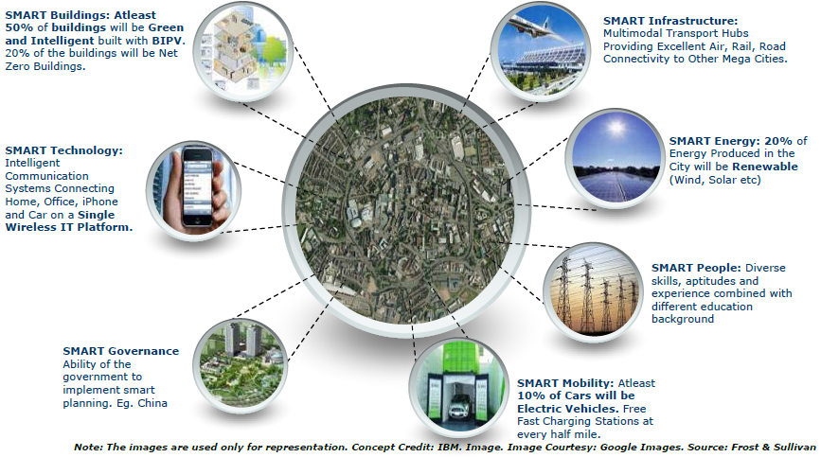
A vision of hyperconnected societies must be underpinned by a robust security framework

Slide 10
Security Challenges in a
Hyperconnected World

Slide 11
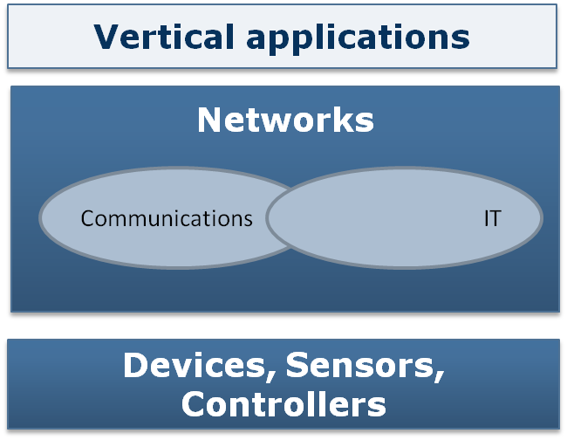

Human and Network Security Challenges
Network related risks
Human related risks
Source: Frost & Sullivan

Slide 12
Emerging human trends in a hyperconnected world
Obsolete business tasks
Pendulum swing on technology spectrum
Proliferation of smart devices
Perception of information value
Can the Human be programmed?
Enterprise mobility / BYOD
Real time intelligence
Emotional responses to social media
Changing perception of privacy
Can the human be programmed?
Source: Frost & Sullivan

Slide 13
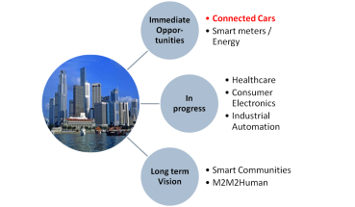
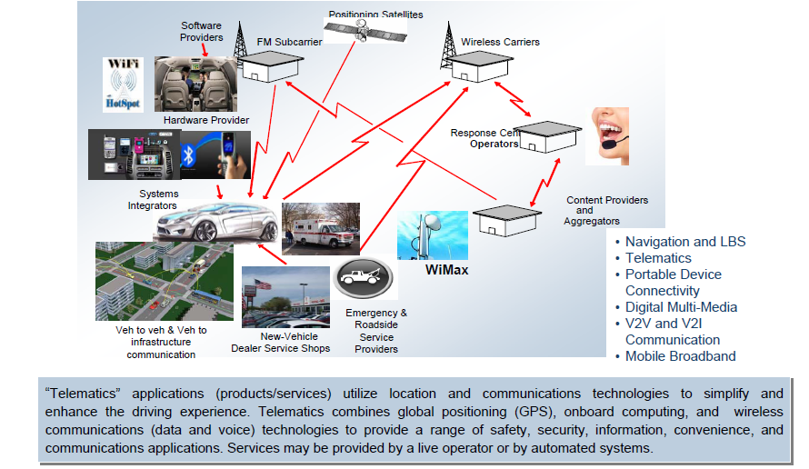
A crowded value chain in Connected Cars
Source: Frost & Sullivan

Slide 14
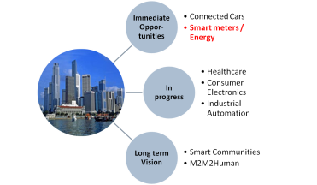
Legislation push for standardisation frameworks in smart meters and smart grid
Smart Metering
Smart metering infrastructure installed at customer’s premises
Home Area Network
Wide Area Network
Utility infrastructure allowing receiving data from metering equipment
Connects in-home devices, including meters
WiFi, Homeplug, Bluetooth, Zigbee, GSM/GPRS, LTE, CDMA, etc.
Connects home and head end computer
IP based network, PLC, optical fibre, GSM/GPRS, 3G, 4G
Source: Frost & Sullivan

Slide 15
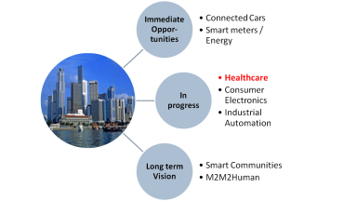
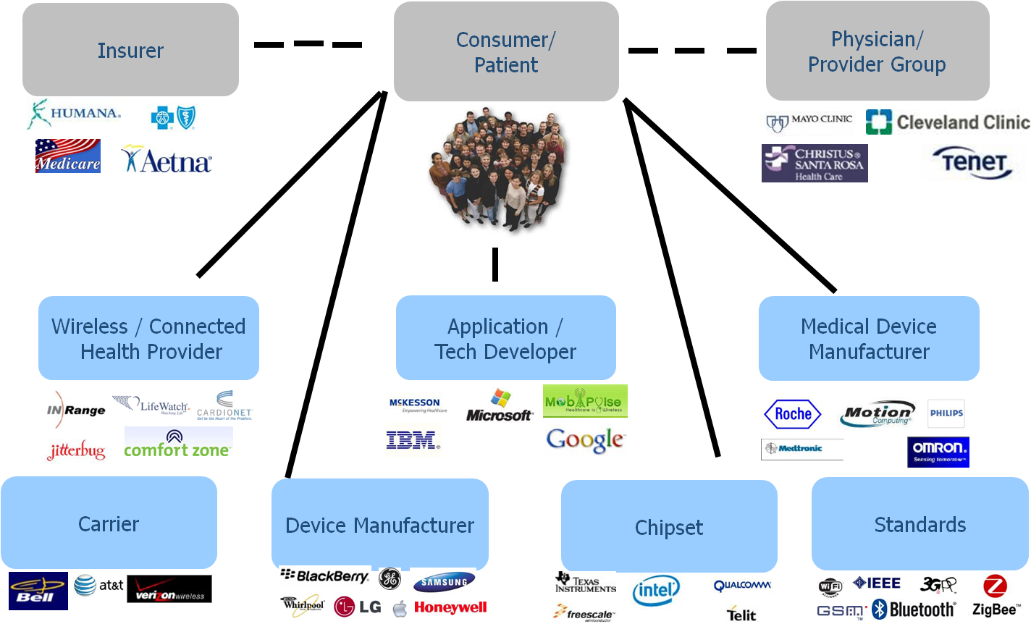
Security requirements underpin M2M deployments in Healthcare
Can the human be programmed?
Source: Veronis & Schuler

Slide 16
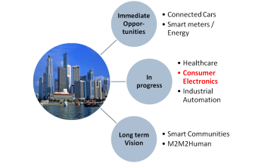
There are high hopes for M2M consumer electronics demand in the medium term
Can the human be programmed?
Source: Frost & Sullivan

Slide 17
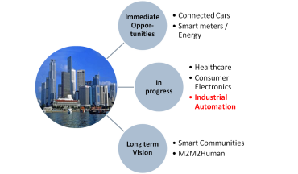

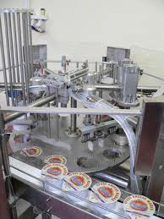


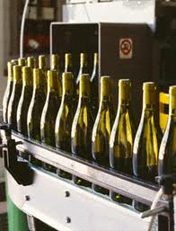
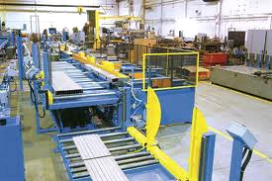
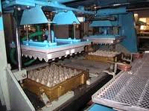
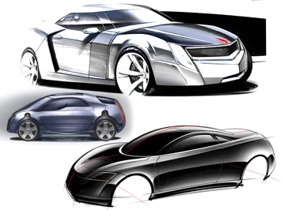
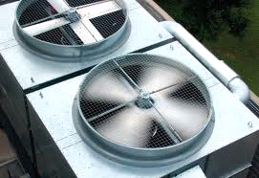
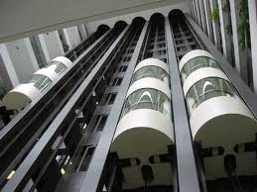
Industrial automation involves processes in critical sectors
Renewable
Energy Sources
Water & Waste Water Management
Power
Generation
Oil &
Gas
Food & Beverages
Industrial Automation & Process Control
Pulp, Paper & Packaging
Automotive Manufacturing
Elevators, Lifts & Cranes
Logistics
HVAC
Source: Frost & Sullivan

Slide 18
M2M service providers’ approaches to overcome security concerns

Slide 19
There is mileage at carving out a trusted vendor reputation
Addressing security concerns
What
Where
How
Source: Frost & Sullivan
Notes:
What/Where/How/By Whom
Implications on security solutions – Big Data (datasets overlay) in smart cities environment, Rise of mob apps, Service Providers’ cloud based offers that address capex constraints etc.
Alliances – Chipsets & Modules, Pushing for security tests at the device level (from telcos and vendors eg Ericsson)

Slide 20
The benefits of building a trusted vendor reputation
M2M in Consumer Electronics
M2M in Smart Energy
Pushing for standardised frameworks
First Mover Advantage
Economies of Scale
M2M in Connected Car
M2M in Healthcare
M2M in Industrial Automation
Source: Frost & Sullivan

Slide 21
Addressing the human element

Slide 22
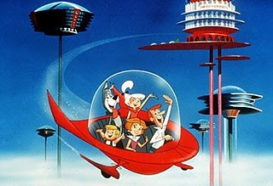


The entrenching power of living in a connected society
Human to Human Communications
Machine to Machine
Objects to Machines to Humans

Slide 23
In Summary
Security concerns in M2M will be a “top of mind” criteria by enterprise customers.
Unresolved security discussions even in immediate M2M opportunities in connected cars and smart meters.
Service providers adopt a cautious attitude towards security challenges; go it alone and participation in standardisation efforts either as an industry alliance or with standardisation bodies.
“Legislative” bodies can overcome coordination problems and speed up efforts
The reality is a hybrid of efforts

Slide 24

For Additional Information
Yiru Zhong, Analyst
Frost & Sullivan
Yiru.zhong@frost.com
+44 207 915 7822
Yiru Zhong is an analyst with Frost & Sullivan’s Information & Communications Technologies Practice where she focuses on communications infrastructure and services. In the last three years, she has added to her research interests the evolution of IT and communications around M2M and ICT in Smart Energy. She has published several M2M related analysis as well as the transformative role ICT has in Smart Energy.
Her team has recently published a newsletter of ICT articles around #SmartCommunities for a Jan/Feb 2013 issue. Your feedback is gratefully received.

